Slide 1
Hospital Data Cleaning and Analysis

Slide 2
Problem Statement
The dataset contains incomplete, inconsistent, and incorrect data
Presence of:
Missing values (NaN)
Incorrect entries (negative age, >100% insurance)
Inconsistent formats (dates, text)
Raw data cannot be used directly for analysis

Slide 3
Dataset Overview
30000
30000
Contains hospital patient records
Key columns:
Patient details (ID, Name, Age, Gender, City)
Admission & discharge dates
Doctor & treatment info
Billing & insurance details
Total features: (17columns , 30000 entries)
Data type: Mixed (numeric + categorical + dates)

Slide 4
Data Issues Identified
Missing values in:
patient_name, city, doctor_name, treatment_type,
admission_date,billing_amount,length_of stay
Invalid values:
Age < 0
Insurance coverage > 100%
Inconsistent formats:
Dates (YYYY/MM/DD, DD-MM-YYYY mix)
Text (male vs Male, paid vs Paid)

Slide 5
Cleaning Approach
Handled missing values using:
"Unknown", "Not Assigned", "General"
Fixed invalid age:
Negative & >100 → converted to NaN
Filled using department-wise median
Standardized text using .str.capitalize()
Converted dates using pd.to_datetime()
Created new features:
insurance_amount
billing_amount
hospital_revenue
length_of_stay

Slide 6
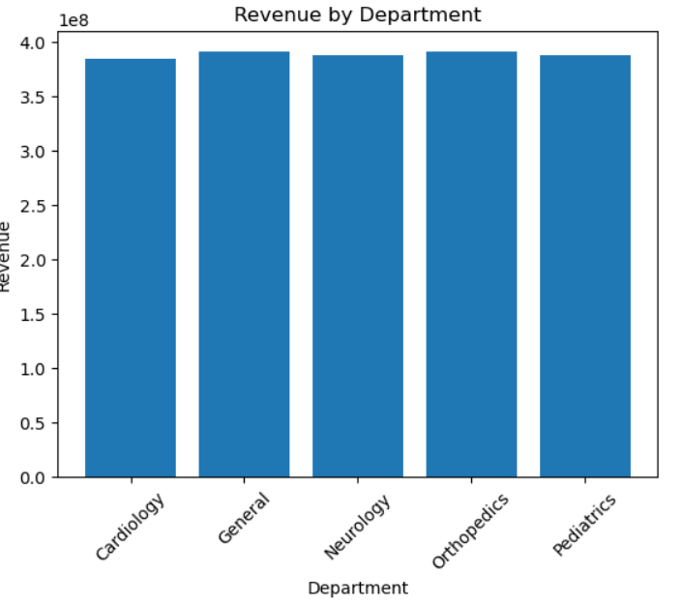
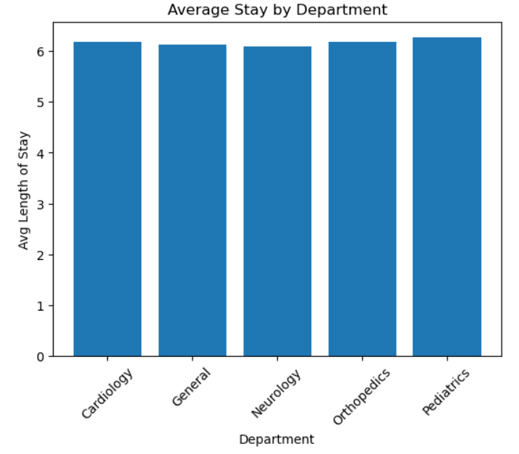
Analysis
Revenue by Department
Explanation:
The data is grouped by department
Total billing amount is calculated for each department
A bar chart is used to visualize revenue distribution
Purpose: To identify which department generates the highest revenue
Average Stay by Department
Explanation:
Data is grouped by department
Average length of hospital stay is calculated for each department
A bar chart is used for visualization
Purpose: To understand which departments have longer patient stays

Slide 7
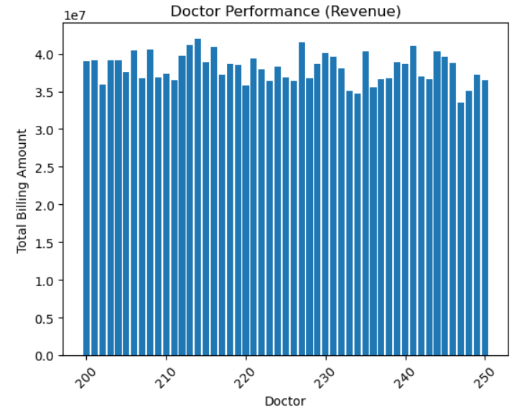
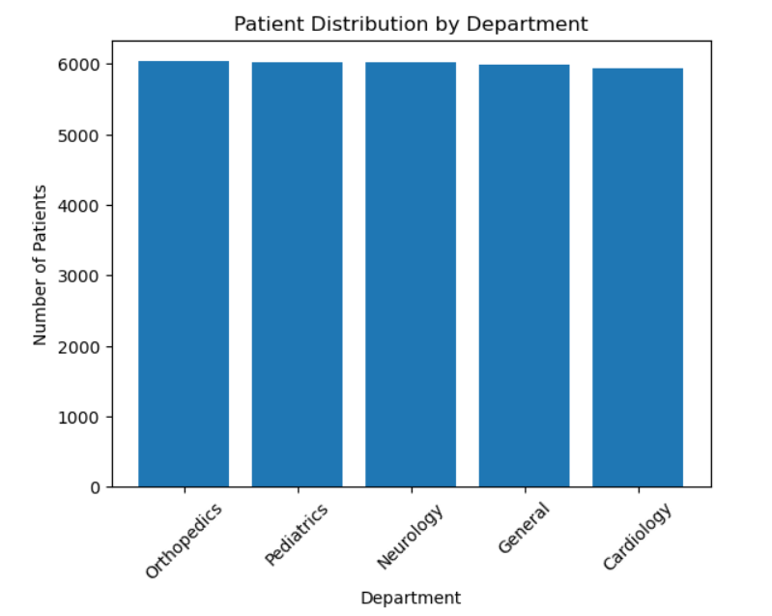
Doctor Performance
Explanation:
Data is grouped by doctor
Total billing amount handled by each doctor is calculated
Results are sorted in descending order
A bar chart is used to display performance
Purpose: To evaluate doctors based on revenue contribution
Patient Distribution
Explanation:
Counts the number of patients in each department
Uses value counts to calculate distribution
A bar chart shows patient flow across departments
Purpose: To identify the busiest departments in the hospital

Slide 8
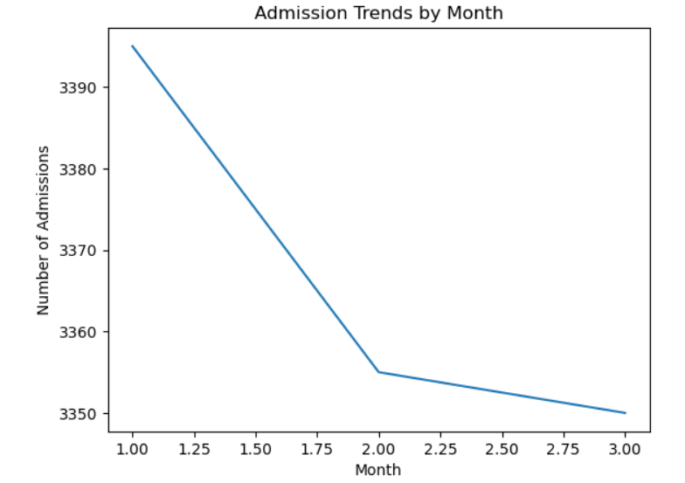
Admission Trends (Monthly)
Explanation:
Admission date is converted into datetime format
Month is extracted from admission dates
Number of admissions per month is calculated
A line chart is used to show trends over time
Purpose: To analyze seasonal or monthly admission patterns

Slide 9
Insights
High-revenue departments are more important for hospital income
Patients stay longer in some departments,that shows those cases are more serious or complex
Few doctors generate most of the revenue this shows doctors performance is not equal
Patients distribution is uneven across departments leads to an imbalance in workload
Patient admissions change every month, and some months have more patients than others.

Slide 10
Recommendations
Reduce missing values in admission date, billing amount, and insurance coverage
Ensure proper data entry and consistent formats.
Recommendation: Implement validation rules at data entry level.
Departments with high patient load and long stay need more beds, staff, and equipment
Recommendation: Allocate resources based on patient volume and average stay duration.
Some doctors treat more patients and generate more revenue than others.
Recommendation: Share patient workload equally among doctors to improve efficiency and reduce stress.
Insurance coverage strongly affects billing amounts.
Recommendation: Study insurance policies to improve payments and reduce costs for patients.
Admissions vary across months showing seasonal patterns.
Recommendation: Adjust staffing, beds, and supplies based on peak admission periods.

Slide 11
Conclusion
Hospital data analysis helps understand patient trends and performance.
Revenue and patient load are not equally distributed across departments.
Some doctors handle more patients and generate higher revenue.
Patient admissions change every month, showing seasonal patterns.
Data analysis helps improve hospital efficiency and decision-making.
It supports better planning, balanced workload, and improved patient care.

